Slide 1
Cloud Computing Architectures
Safia Baloch CE-408

Slide 2
Architecture
Object: offer Computing Horsepower
Layer: Datacenters
Heterogenous Nature
Classification of Services:
Iaas: Combination of cloud hosting platforms and resources.
Paas: Development Platform for application
Saas: Service at application level
Xaas: Combination of Cloud services

Slide 3
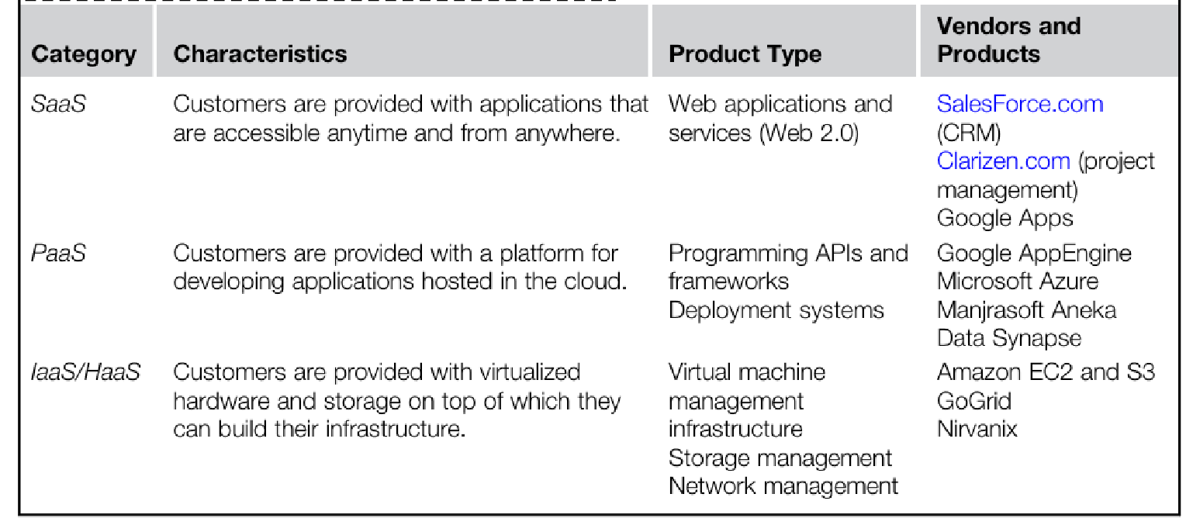
Cloud Computing Services Classification

Slide 4
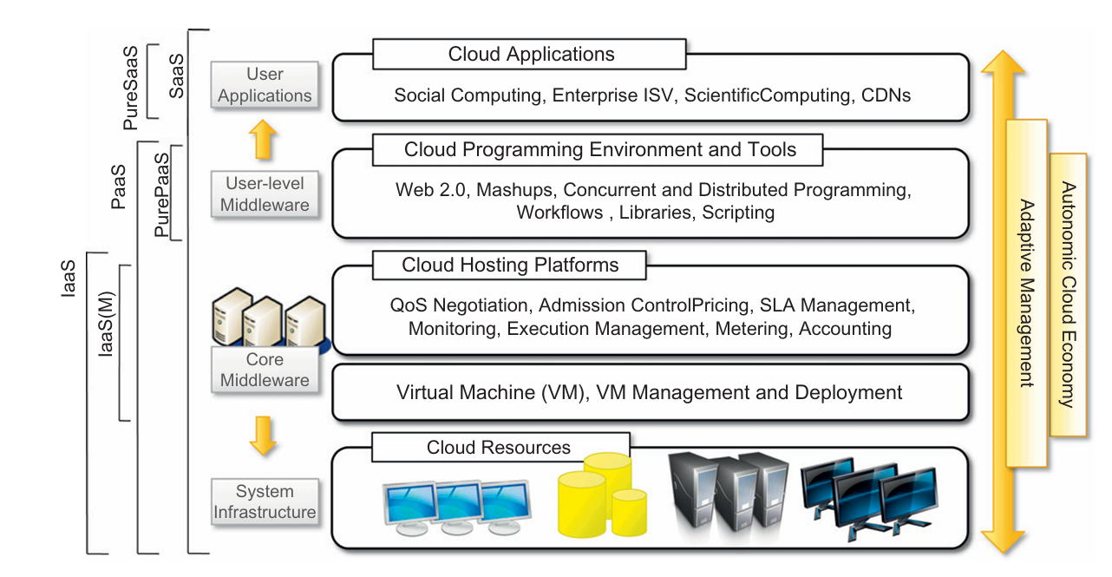
Reference Model:

Slide 5
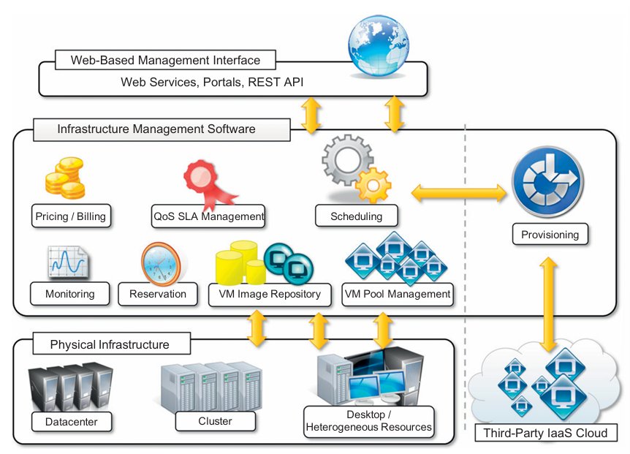
Iaas

Slide 6
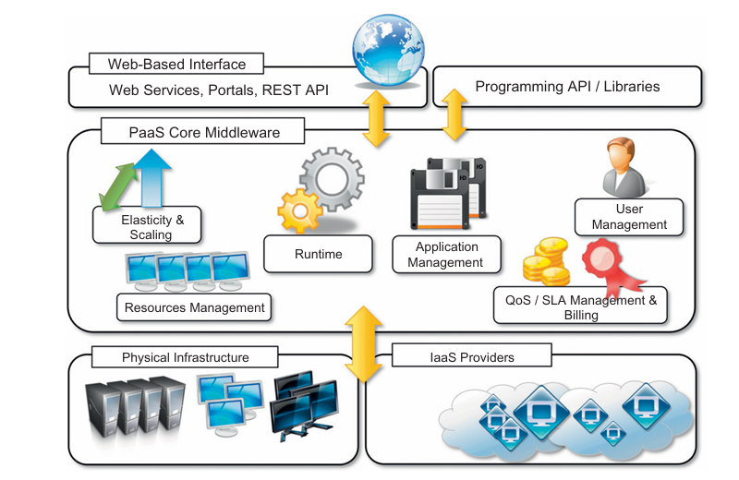
Paas

Slide 7
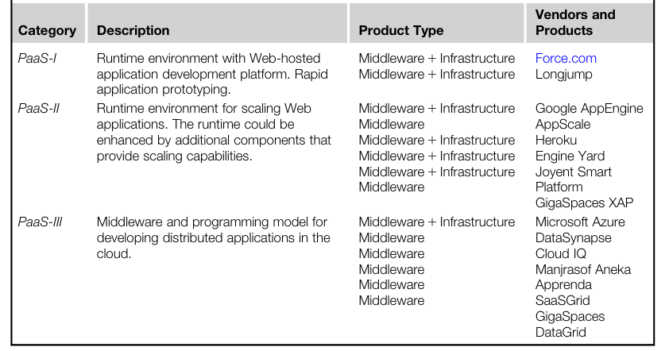
Paas Offering Classification
Essential Characteristics:
Runtime Framework
Abstraction
Automation
Cloud Services
Note: Vendor Lock-in

Slide 8
Cloud Programming Model: Server-less Computing
CE-408
Safia Baloch

Slide 9
Google App Engine/Amazon EC2
Eight issues to be addressed in setting up an environment for cloud users.
Redundancy for availability, so that a single machine failure doesnt take down the service.
Geographic distribution of redundant copies to preserve the service in case of disaster.
Load balancing and request routing to efficiently utilize resources.
Autoscaling in response to changes in load to scale up or down the system.
Monitoring to make sure the service is still running well.
Logging to record messages needed for debugging or performance tuning.
System upgrades, including security patching.
Migration to new instances as they become available

Slide 10
Server-less Cloud
Cloud user simply writes the code and leaves all the server provisioning and administration tasks to the cloud provider.
While cloud functions packaged as FaaS (Function as a Service) offerings (AWS lambda, GCF, IBM Clou Function, Azure Functions) represent the core of serverless computing,
cloud platforms also provide specialized serverless frameworks that cater to specific application requirements as BaaS (Backend as a Service) offerings.
Serverless Computing = FaaS +BaaS

Slide 11
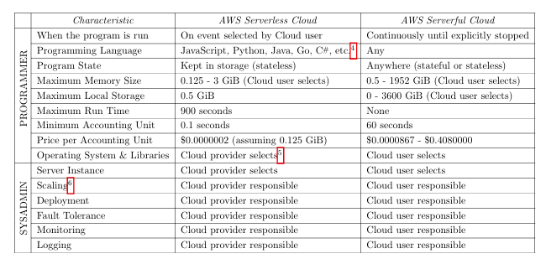
Emergence of Server-less Computing
summary of differences between serverless and the traditional approach.

Slide 12
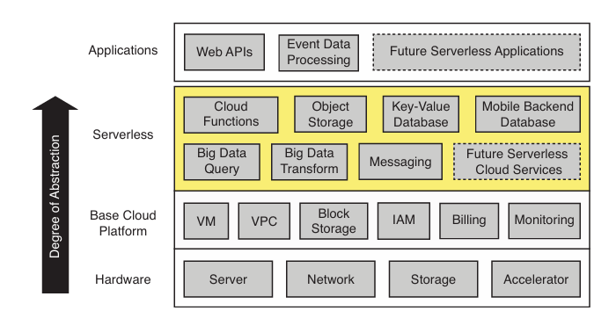
There are three critical distinctions between serverless and serverful computing
Decoupled computation and storage.
Executing code without managing resource allocation.
Paying in proportion to resources used instead of for resources allocated.
The serverless layer sits between applications and the base cloud platform, simplifying cloud programming.
Cloud functions (i.e., FaaS) provide general compute and are complemented by an ecosystem of specialized Backend as a Service (BaaS) o erings such as object storage, databases, or messaging.
The base underlying base cloud platform includes virtual machines (VM), private networks (VPC), virtualized block storage, Identity and Access Management (IAM), as well as billing and monitoring.

Slide 13
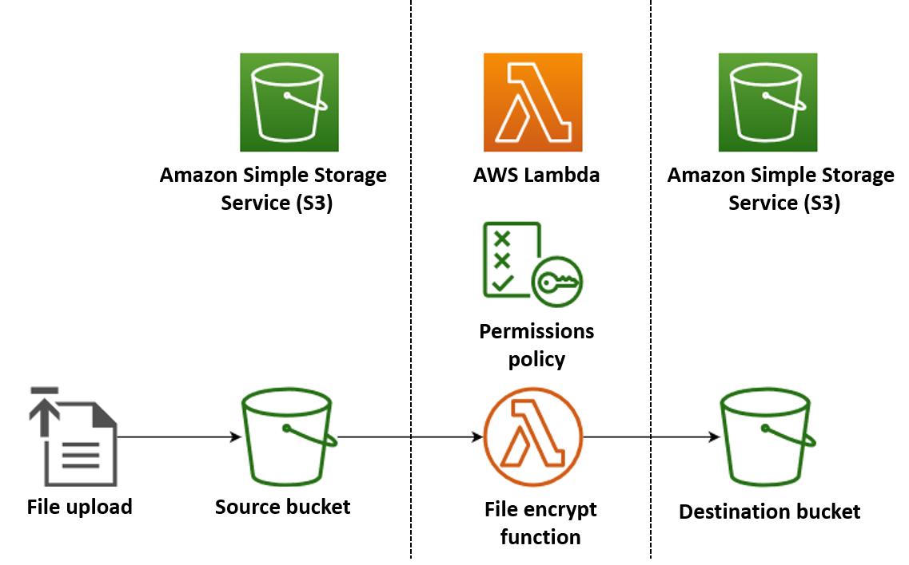
Serverless Apps
In this example, you create an app which automatically encrypts PDF files when they are uploaded to an Amazon Simple Storage Service (Amazon S3) bucket. To implement this app, you create the following resources:
An S3 bucket for users to upload PDF files to
A Lambda function in Python which reads the uploaded file and creates an encrypted, password-protected version of it
A second S3 bucket for Lambda to save the encrypted file in

Slide 14
Limitations of today’s serverless computing Platforms
Hostel Task

Slide 15
Discuss
How does serverless computing relates to Kubernetes?

